Slide 1




Introduction
Project:
Car Claim Analysis
Aim:
To analyze the factors affecting the car insurance premium
Who are we helping:
Senior Managers of Insurance Company

Slide 2

Business Context
An insurance company always needs to be prepared to estimate the number of accidents and the claims that they can receive at a given point time.
Also understanding the pattern of claims would help the companies to frame different types of policies for the users providing better benefits and at the same time increasing the premium to the company.

Slide 3

Demo
https://public.tableau.com/app/profile/sai.kiran7316/viz/saikiran/Analysis?publish=yes

Slide 4
Data Description
Variable | Description | Explanation
AGE | Age of Driver | Very young people tend to be risky. Maybe very old people aiso.
BLUEBOOK | Value of Vehicle
CAR AGE | Vehice Age.
CAR TYPE | Type of Car
CAR USE | Vehicle Use | Commercial vehicles are driven more, so might increase probability of collision.
CLM FREQ | # Claims (Past 5 Years) | The more claims you filed in the past, the more you are likely to file in the future
EDUCATION | Max Education Level
HOMEKIDS | # Children at Home
HOME VAL | Home Value | In theory, home owners tend to drive more responsibly
INCOME | Income | In theory, rich people tend to get into fewer crashes
JOB | Job Category | In theory, white collar jobs tend to be safer
KIDSDRIV | # Driving Children | When teenagers drive your car, you are more likely to get into crashes
MSTATUS | Marital Status | In theory, married people drive more safely
MVR PTS | Motor Vehicle Record Points | If you get lots of traffic tickets. you tend to get into more crashes
OLDCLAIM | Total Claims (Past 5 Years) | If your total payout over the past five years was high, this suggests future payouts will be high
PARENT1 | Single Parent | Unknown effect
RED CAR | A Red Car | Urban legend says that red cars (especially red sports cars) are more risky. Is that true?
REVOKED | License Revoked (Past 7 Years) | If your license was revoked in the past 7 years, you probably are a more risky driver.
SEX | Gender | Urban legend says that women have less crashes then men. Is that true?
TIF | Time in Force | People who have been customers for a long time are usually more safe
TRAVTIME | Distance to Work | Long drives to work usually suggest greater risk
URBANICITY | Home/Work Area
YOJ | Years on Job | People who stay at a job for a long time are usually more safe
Data Source : https://www.kaggle.com/datasets/xiaomengsun/car-insurance-claim-data

Slide 5
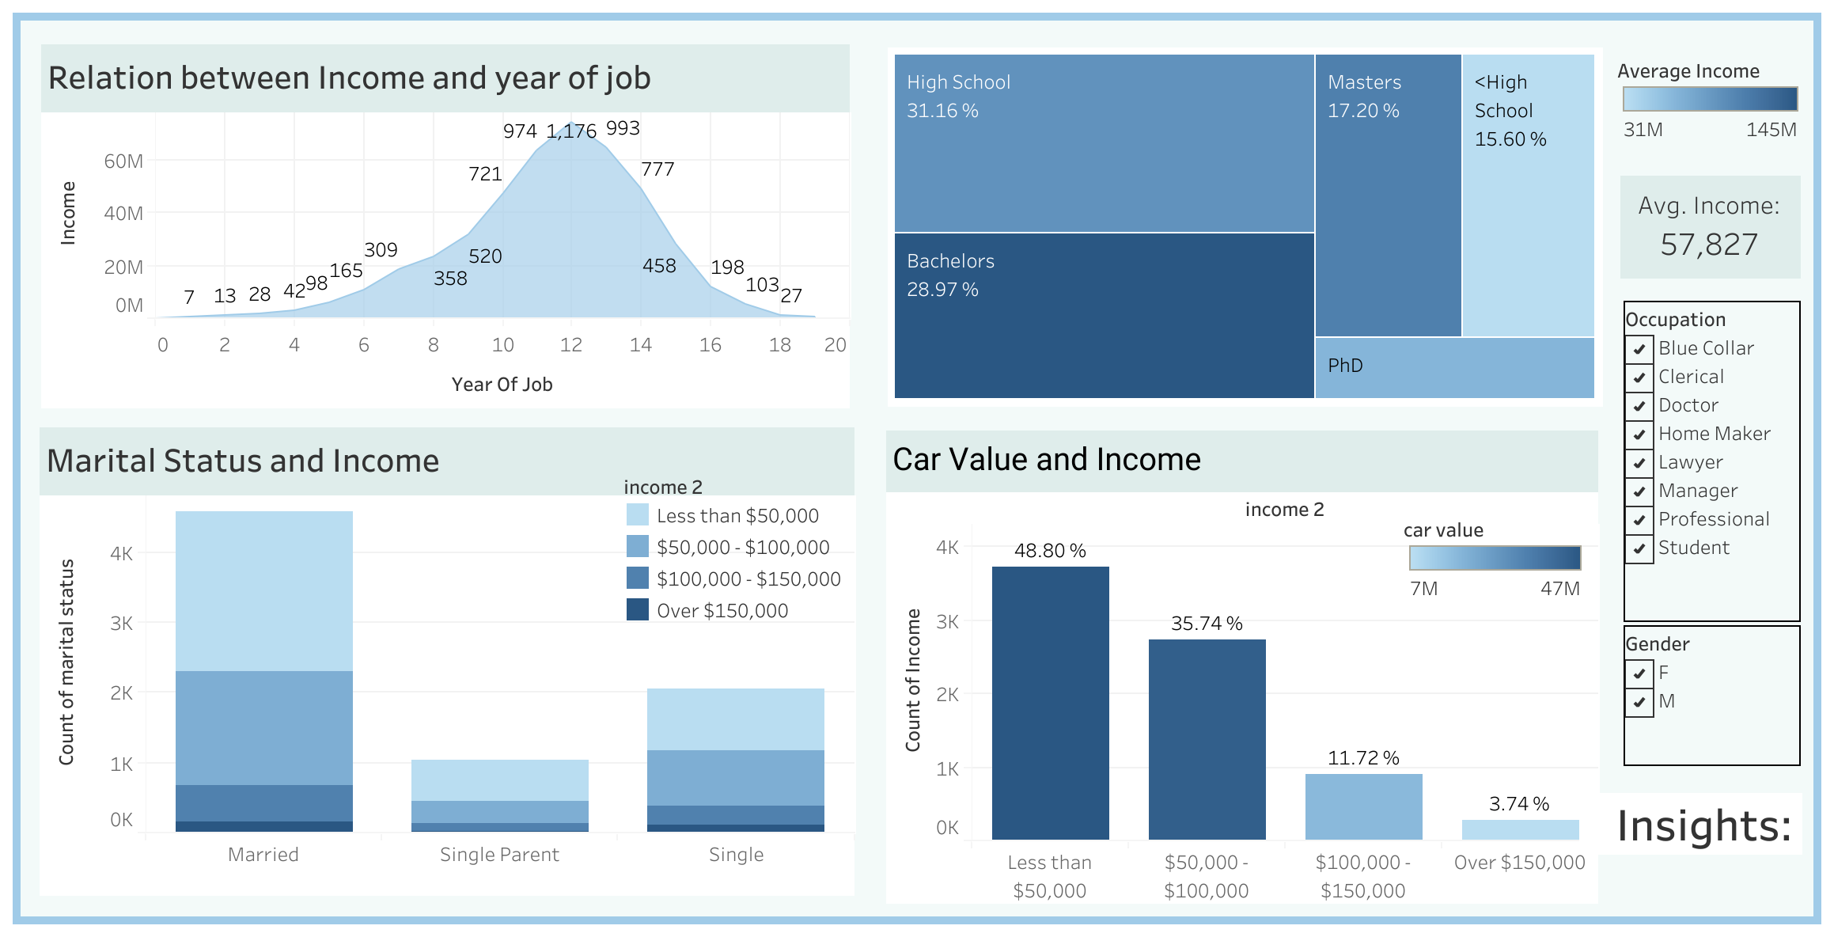
Owner Income Analysis

Slide 6
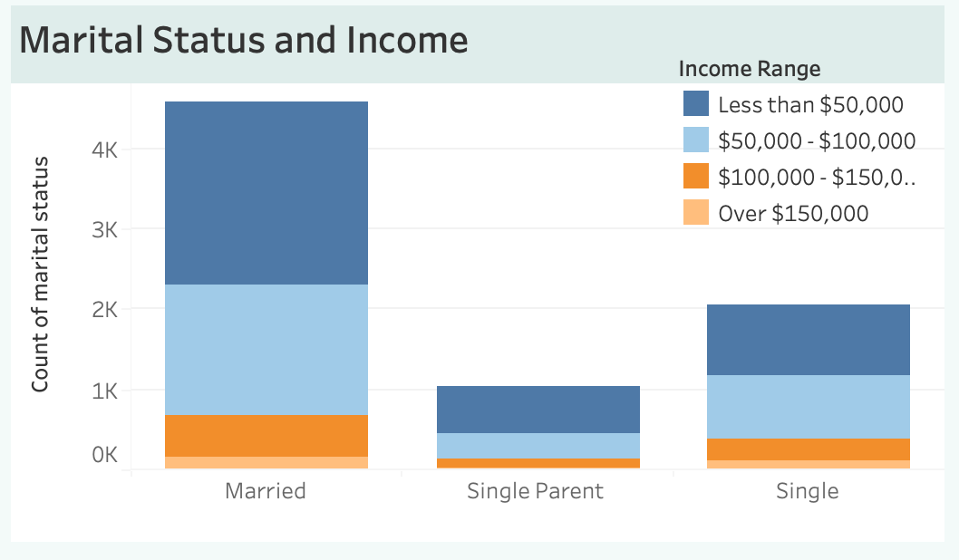
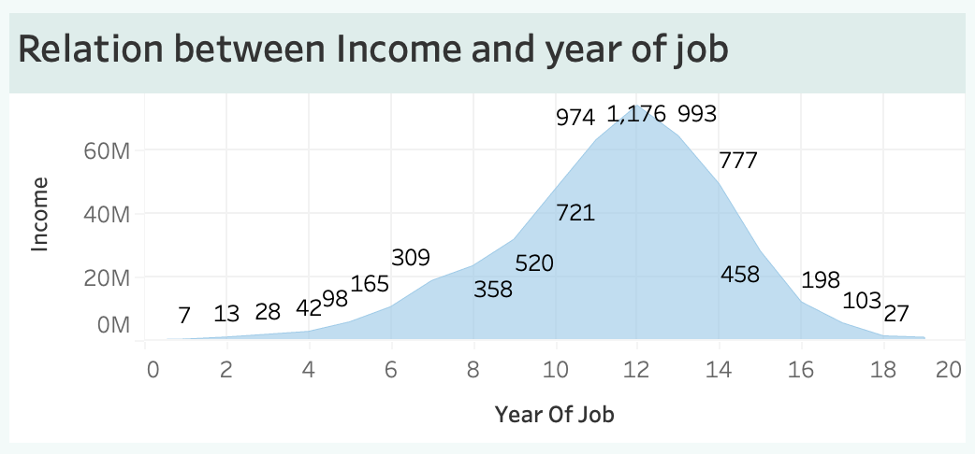
Owner Income Analysis
Owner analysis: Majority of customers have 12 years of job experience with higher income. Most customers are married with an income below $50,000. Customers with a Bachelor's degree have a higher income. 48.80% of customers have an income below $50,000, whereas only 3.74% of customers have an income exceeding $150,000.

Slide 7
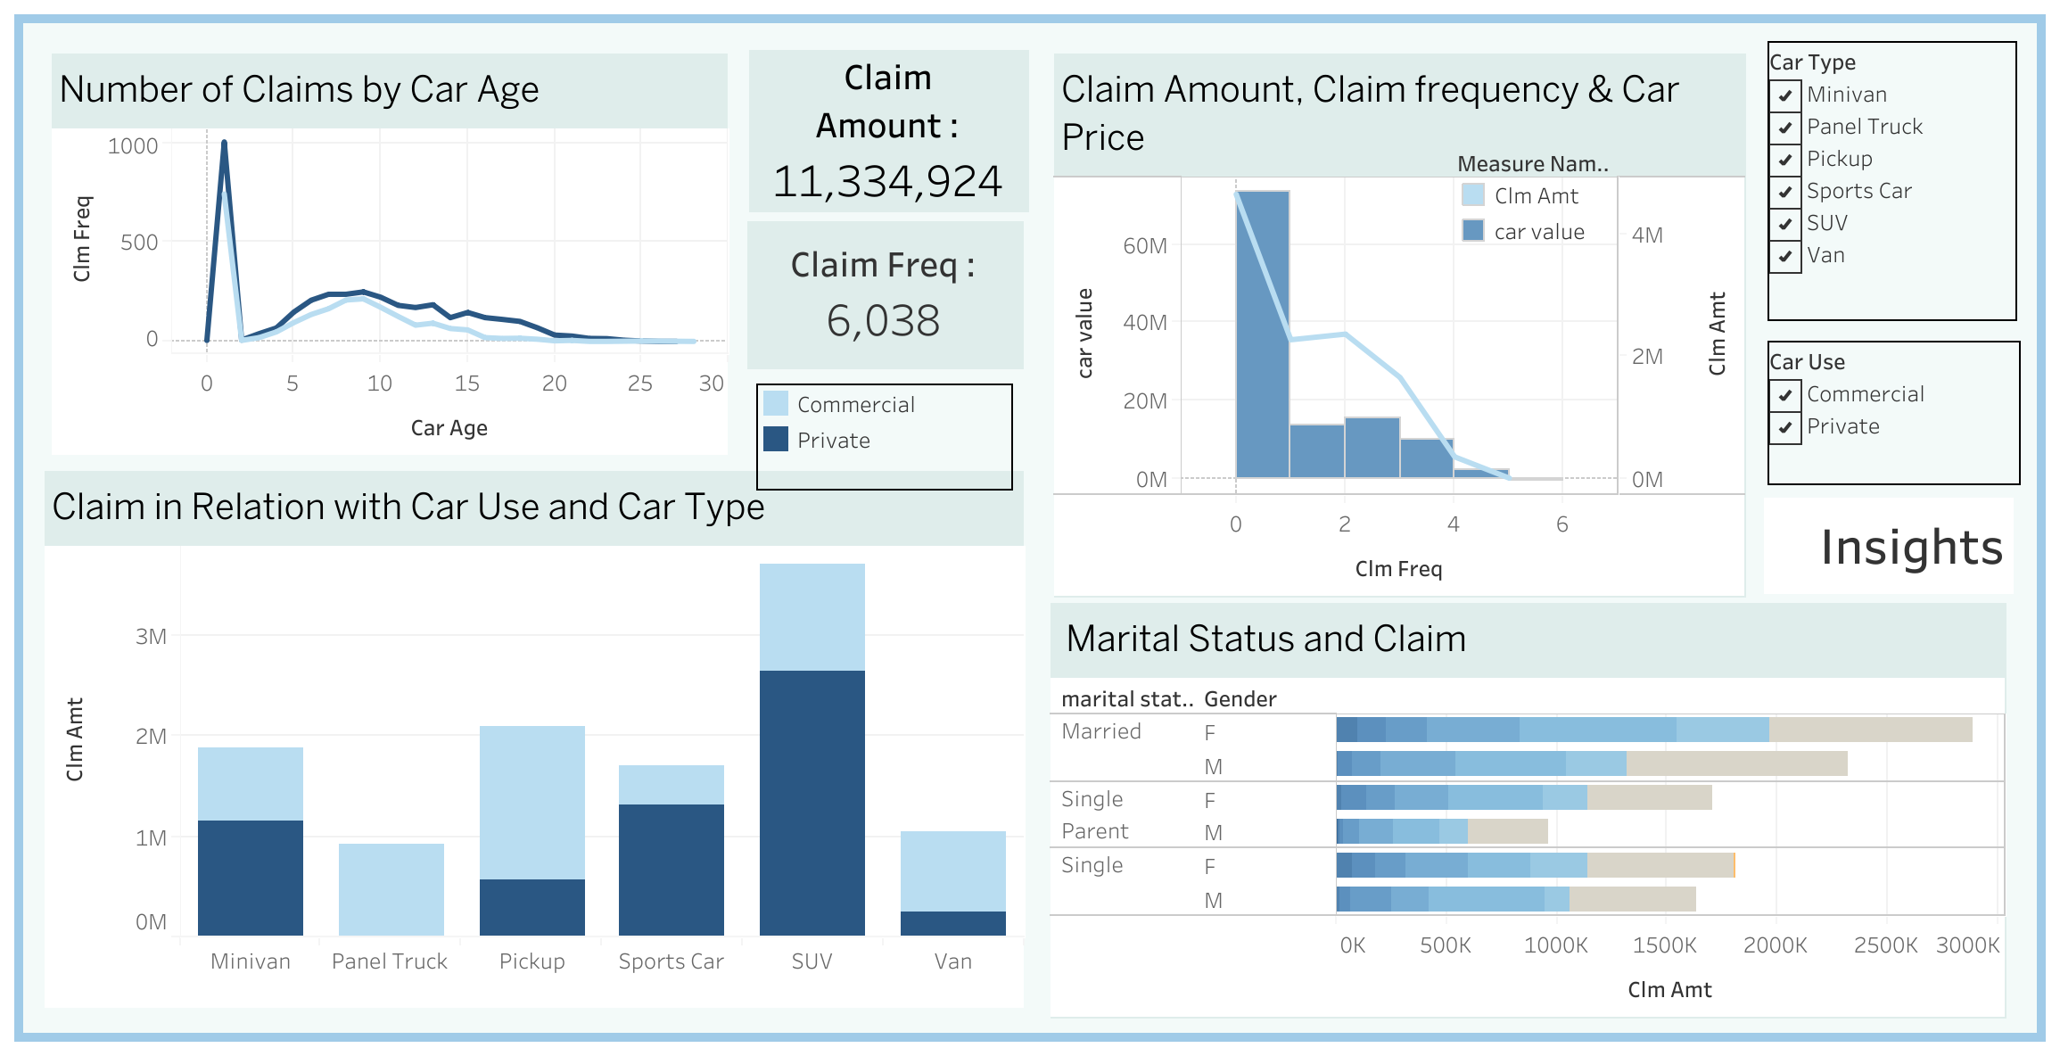
Claim Analysis

Slide 8
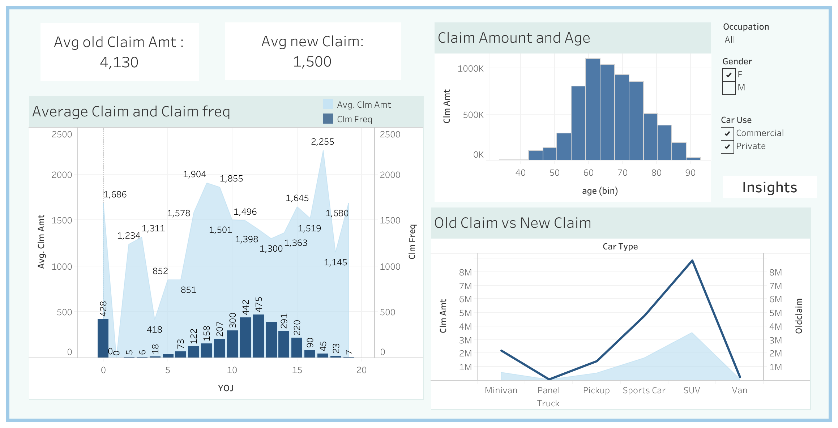
Claim Analysis

Slide 9
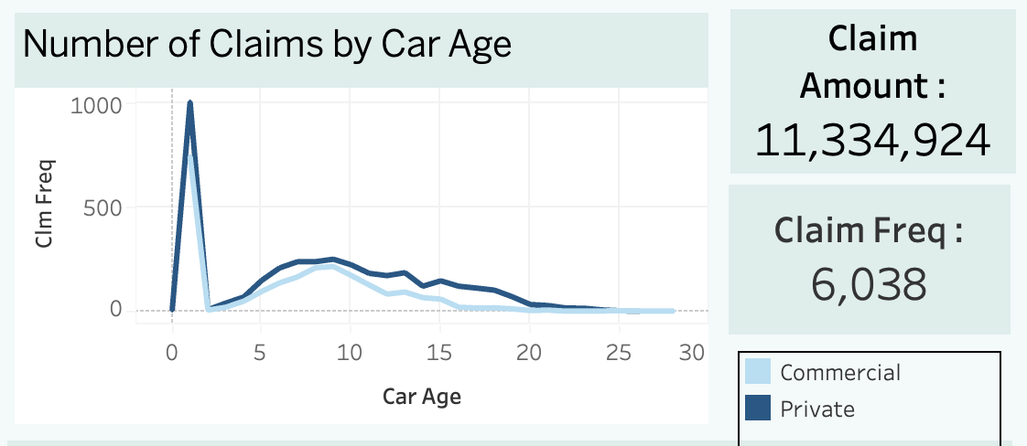
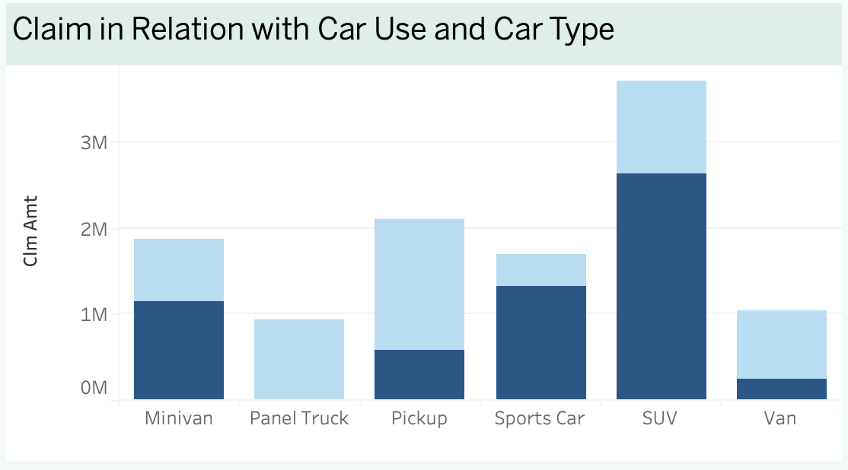
Claim Analysis
Claim analysis: Customers with cars aged 0-2 years have the highest claim frequency. Married females have the highest claim amount. SUV car owners have a higher claim amount than other car types, and most SUV car owners use their vehicles for private purposes. Most customers use panel trucks for commercial purposes. The claim amount for private cars is higher than for commercial cars.

Slide 10
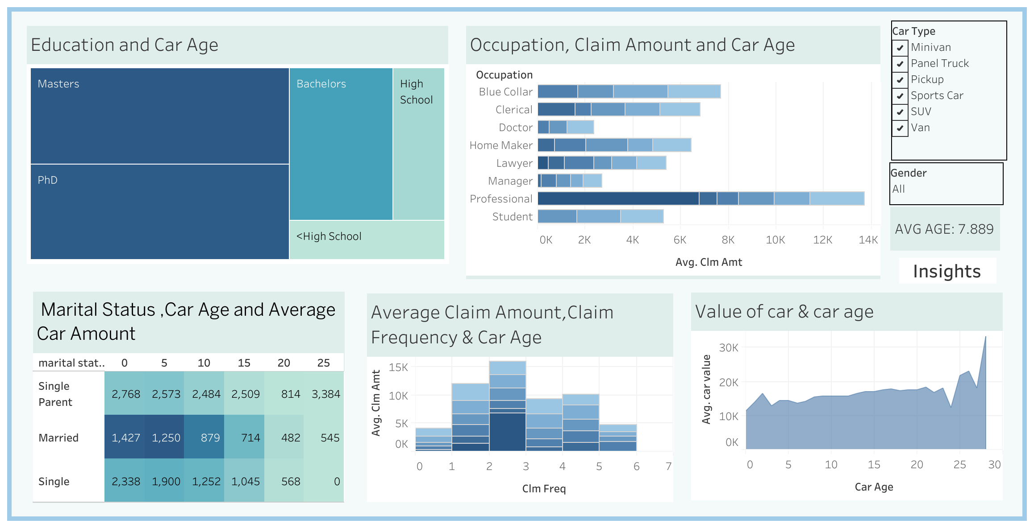
Car Age Analysis

Slide 11
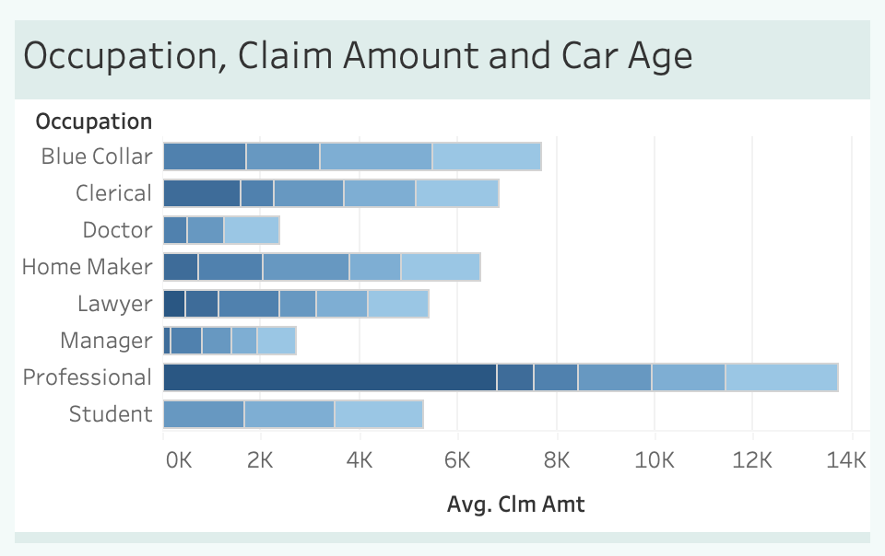
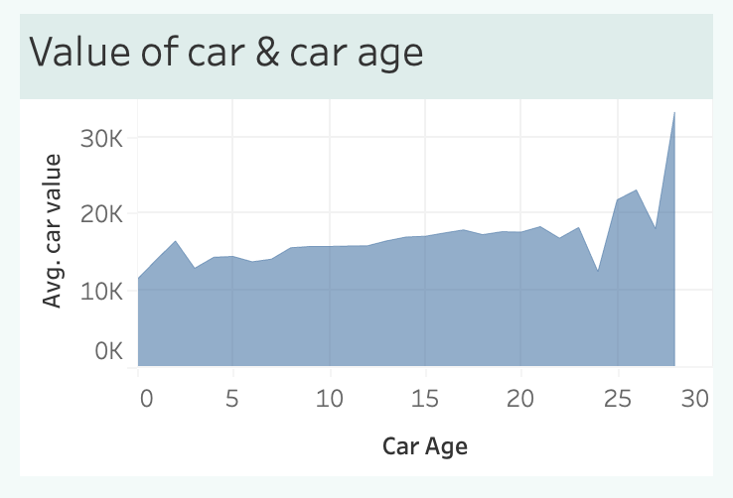
Car Age Analysis
Car age analysis: Customers with 0, 9,17 years of job experience have a high average claim amount. Customers of age 53 - 74 yrs claim high amount. The average amount of claims for before 5 years was more as compared to last 5 years. There is a huge difference between the average claim amount before and after the last 5 years for men who use cars for private use.

Slide 12
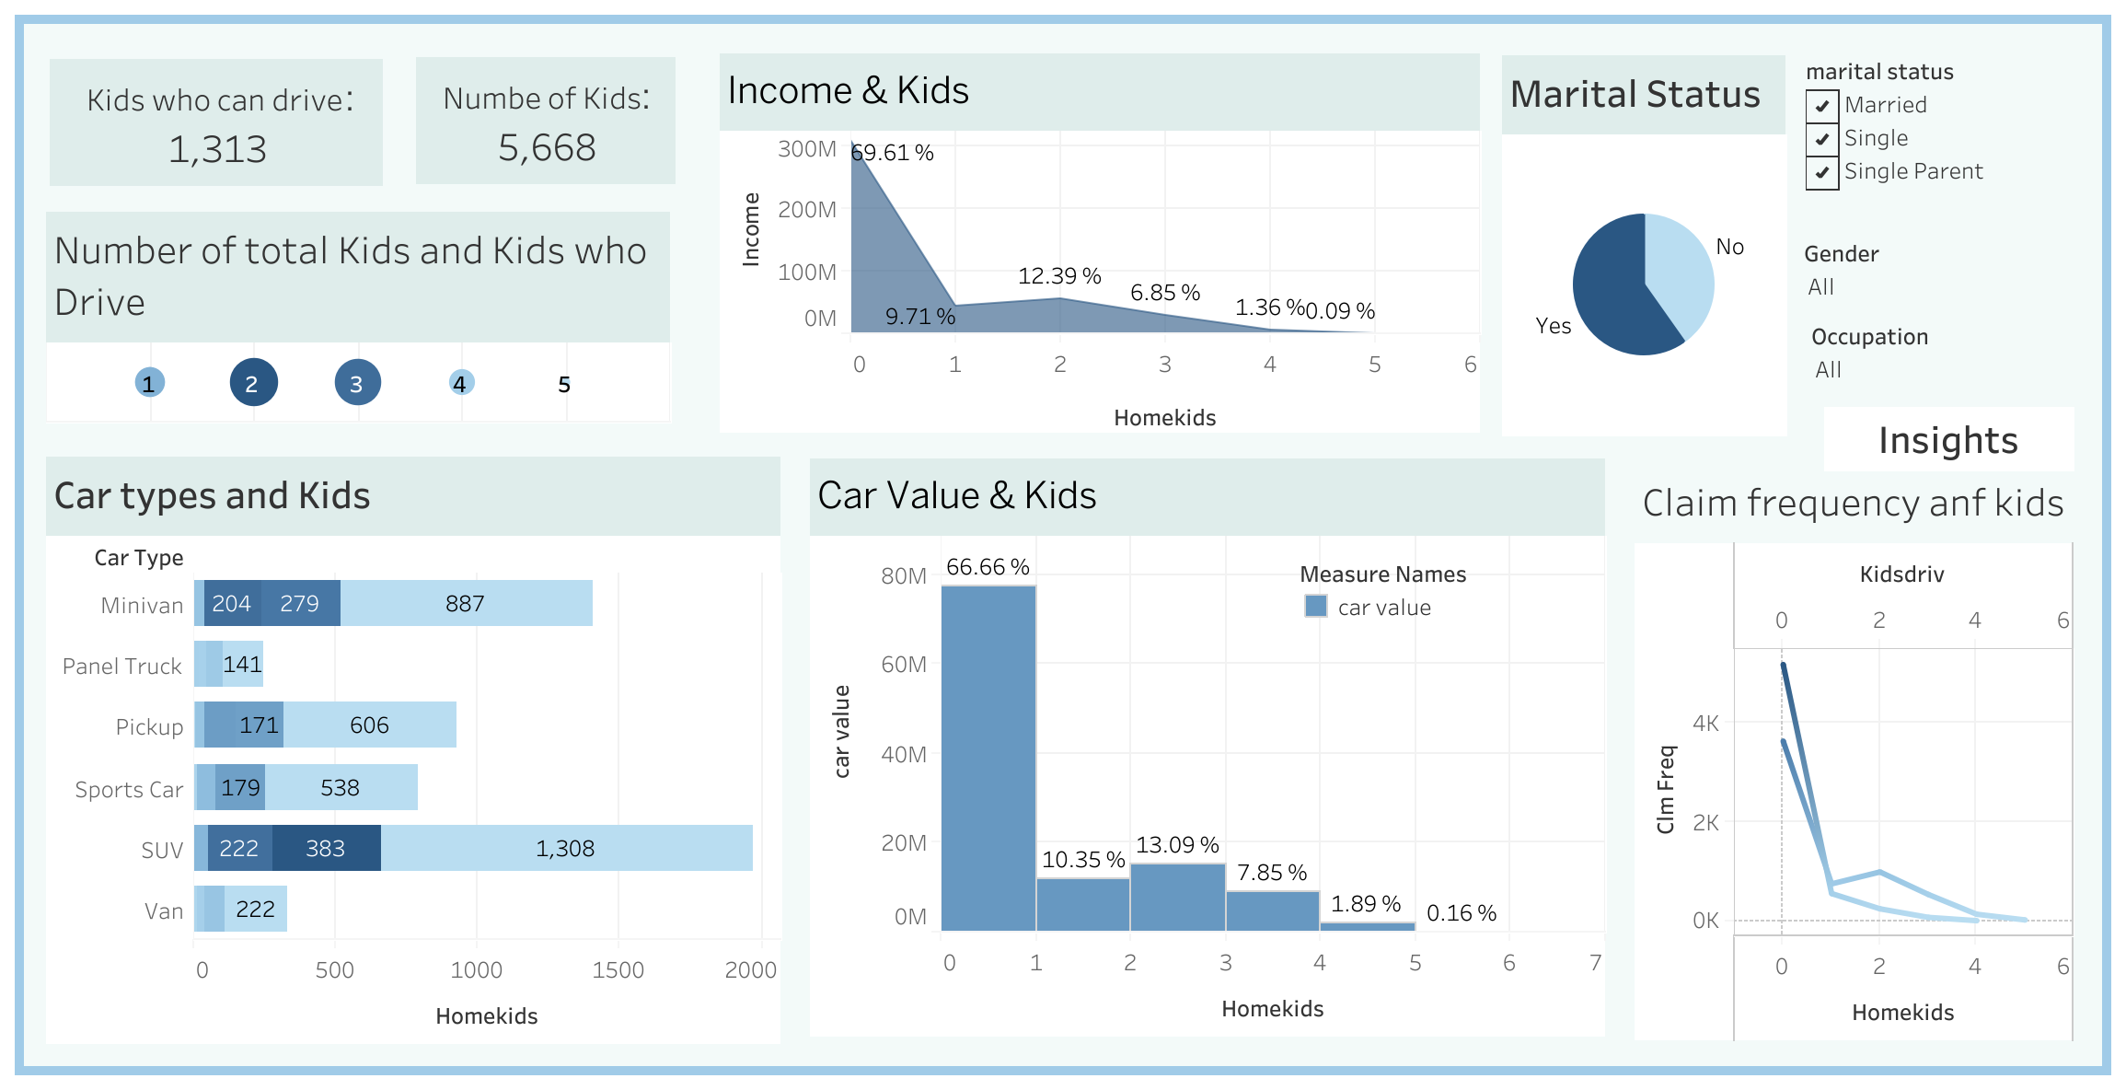
Kids Analysis

Slide 13
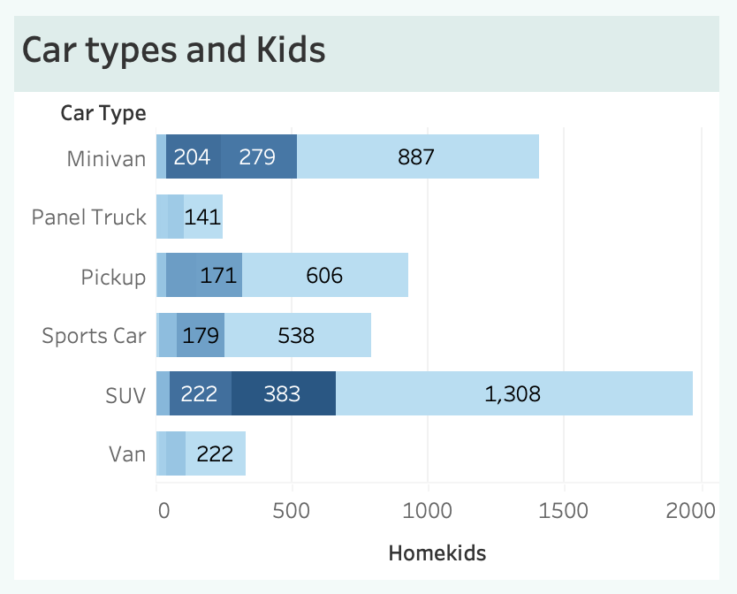
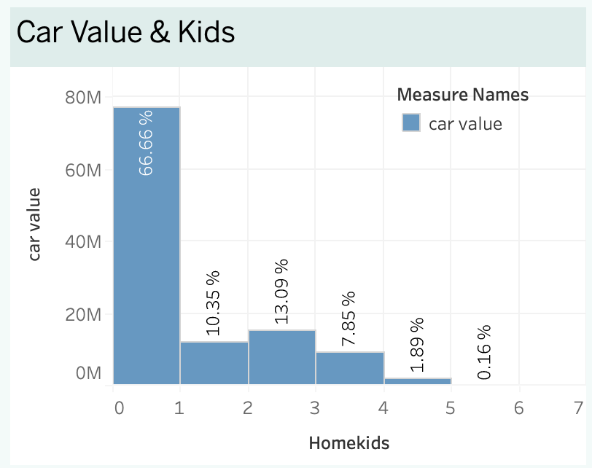
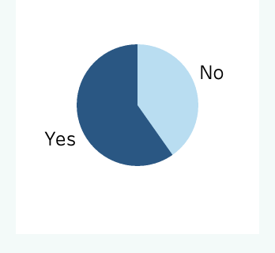
Kids Analysis
Kids analysis: 59.78% of people are married, and 40.22% are single parents and single. Most people who have children have 2 children. Most children drive SUVs. 66.66% of customers have 0 kids, and single parents have 2 children.

Slide 14
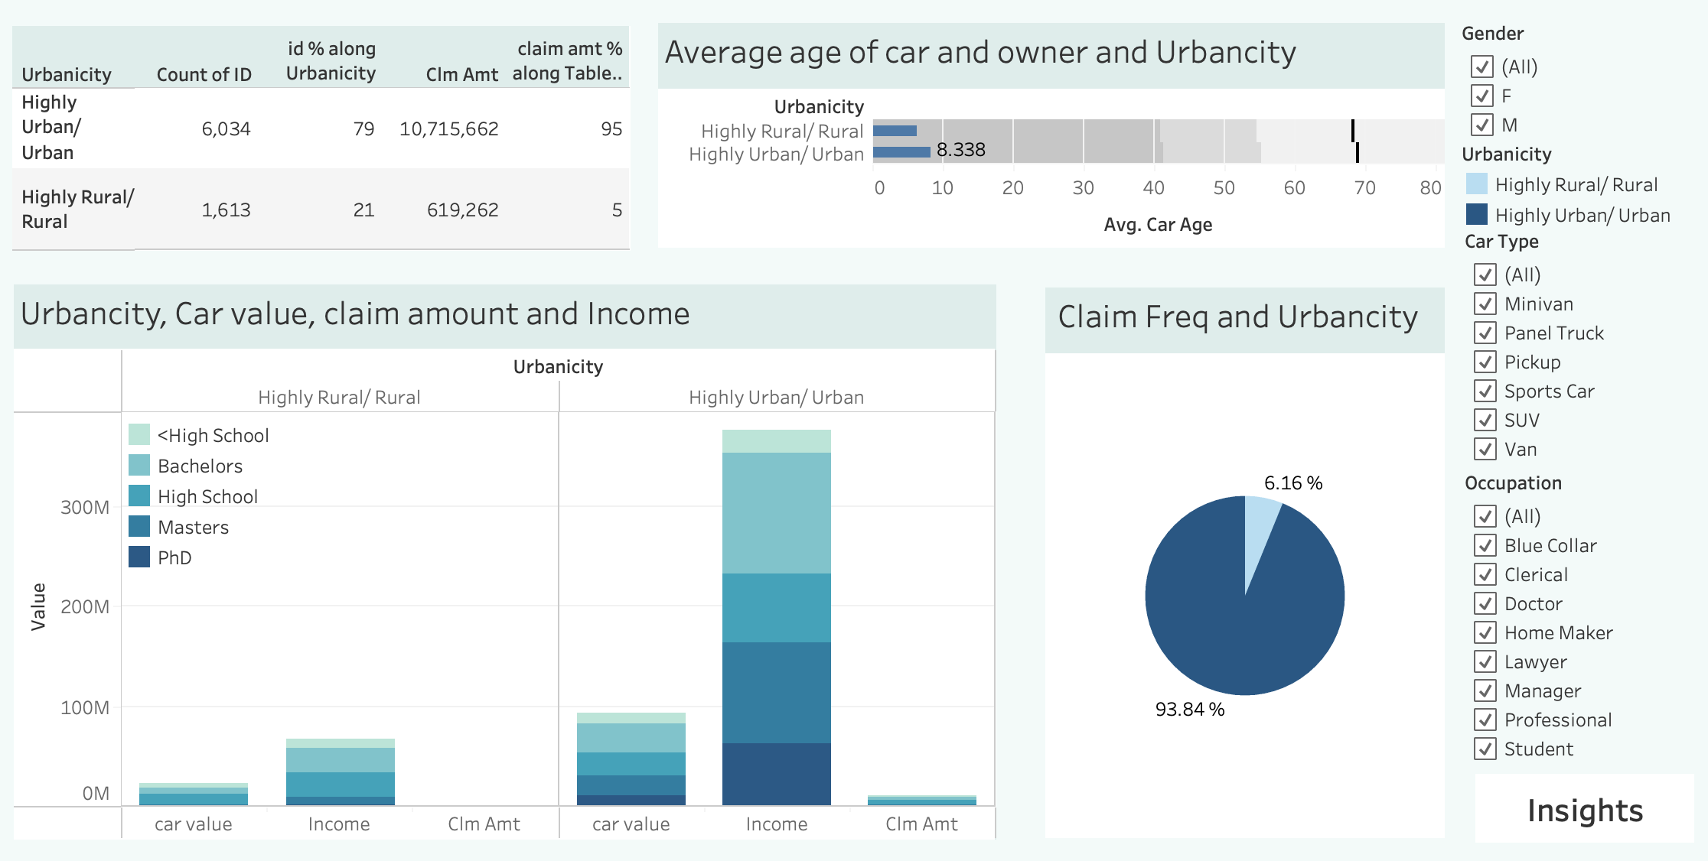
Urbanicity Analysis

Slide 15
Urbanicity Analysis

Slide 16
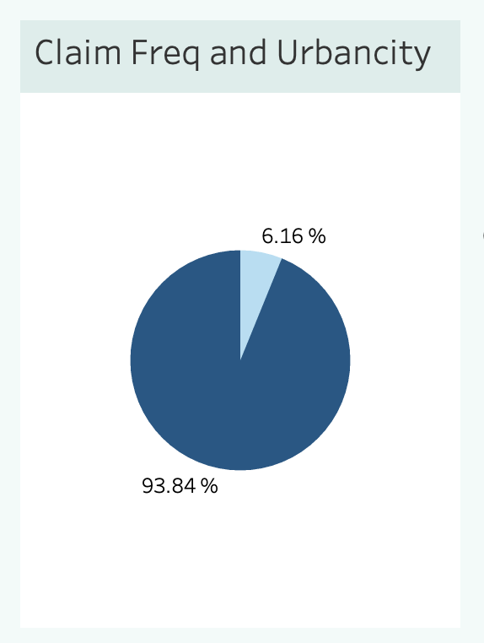
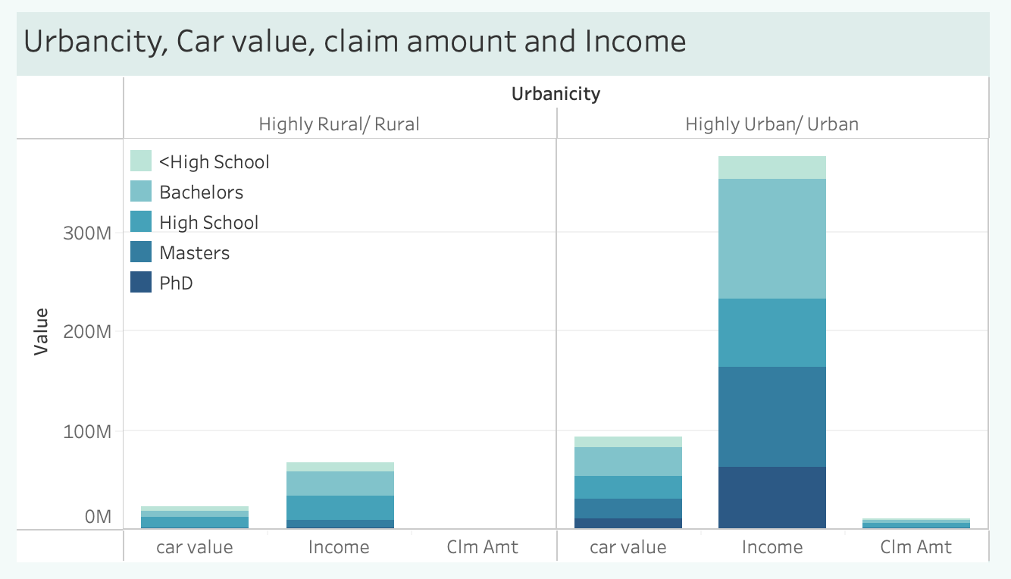
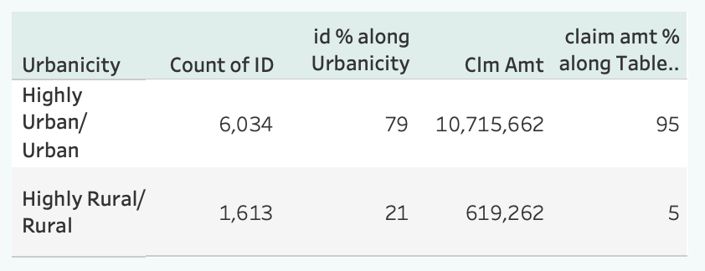
Insights
Urban/Rural: Only 6.16% of customers reside in rural areas, while the rest 93.84% live in urban areas. Customers in urban areas tend to have more valuable cars and are more highly educated. 95% of the claim amount is from urban customers, and 79% of the total customers are from urban areas.

Slide 17
10 Recommendations
1. Focus on married customers with an income below $50,000, as they represent a large proportion of the customer base.
2. Provide incentives for customers who have completed higher levels of education, as they tend to have higher incomes and may be more likely to purchase additional coverage.
3. Offer specialized coverage for SUV owners, as they tend to have higher claim amounts than other car types.
4. Create packages that cater specifically to customers who use their cars for commercial purposes, as they tend to have higher claim frequencies and may require different types of coverage.
5. Consider offering coverage for older cars, as customers with cars aged 0-2 years have the highest claim frequency.
6. Focus on single parents with cars aged more than 25 years, as they have the highest average claim amount.
7. Provide incentives for customers who have been employed for 12 years or more, as they represent a large proportion of the customer base and may be more likely to purchase additional coverage.
8. Develop specialized coverage for customers with children, as they tend to have different needs and may require additional protection.
9. Consider offering coverage that is specific to urban and rural areas, as customers in these areas have different needs and may require different types of coverage.
10. Consider offering specialized coverage for highly educated customers with valuable cars, as they represent a unique demographic with different needs and may be willing to pay more for additional coverage.

Slide 18
Thanks for Listening!

